Slide 1

Hospital Appointment & Doctor Scheduling System

Slide 2
Team Members
2420030164 | P.Moukshitha
2420030156 | B.Kamalesh
2420030136 | A.Srinivas
2420030264 | Y.Yamini

Slide 3
Problem Statement
In many hospitals and clinics, the process of booking appointments with doctors is often manual, time-consuming, and prone to errors. Patients frequently face long waiting times, difficulty finding available doctors, and the risk of double-booked appointments. Doctors, on the other hand, struggle to manage their schedules efficiently and keep track of patient details.
This system aims to provide an online solution that allows patients to book appointments easily, enter personal details such as name, age, place, and health issue, and view their upcoming appointments. Simultaneously, doctors can access their schedule and view relevant patient information, helping streamline hospital operations and reduce errors.

Slide 4
Objective
The main objectives of the Hospital Appointment and Doctor Scheduling System are:
Enable Patients to Book Appointments Easily – Allow patients to select doctors, enter their personal details, and schedule appointments online.
Store Patient Information – Maintain details such as name, age, place, and health issue for each patient.
Assist Doctors in Managing Schedules – Let doctors view their appointment schedules and access patient details efficiently.
Prevent Double Booking – Ensure that a doctor cannot be booked for the same time slot by multiple patients.
Provide Secure Login – Allow both doctors and patients to log in with unique usernames and passwords.
Improve Efficiency and Reduce Errors – Streamline the appointment process, reduce waiting times, and minimize manual errors.

Slide 5
System Users
Patient
Role: The patient is the main user who needs to book medical appointments with doctors.
Responsibilities and Features:
Login: Access the system with a unique username and password.
Provide Details: Enter personal information such as:
Name
Age
Place
Health Issue / Cause of Visit
Book Appointments: Choose a doctor and select a suitable date and time.
View Appointments: Check upcoming appointments and confirm bookings.
Goal: To make the appointment process easy, fast, and error-free for patients, reducing waiting times and ensuring proper scheduling.

Slide 6
System Users
Doctor
Role: The doctor is a user who provides medical consultations and manages appointments.
Responsibilities and Features:
Login: Access the system with a unique username and password.
View Schedule: See all upcoming appointments with patients.
Access Patient Details: Check each patient’s information, including:
Name
Age
Place
Health Issue / Cause of Visit
Manage Appointments: Ensure no double booking occurs and manage availability efficiently.
Goal: To help doctors organize schedules, track patients, and provide timely consultations without confusion or errors.

Slide 7
Predefined Users-Patients:--→ Doctors: | alice/alice123, bob/bob123
Username | Password
john | john123
jane | jane123

Slide 8
Features
Login System
Secure login for both patients and doctors with unique usernames and passwords.
Patient Dashboard
Enter personal details: Name, Age, Place, Health Issue.
Book appointments with selected doctors.
View all upcoming appointments.
Doctor Dashboard
View schedule of appointments.
Access detailed patient information for each appointment.
Appointment Management
Prevents double booking for doctors.
Allows patients to select convenient date and time.
Dynamic Front-End
User-friendly web interface with responsive design and background styling.
Future Ready
Can be extended to a full-stack system with database support for persistence.

Slide 9
Workflow
Login → Dashboard → Book/View Appointments
1
Patients → Input details → Select doctor → Book time
2
Doctors → View schedule → Check patient details
3

Slide 10
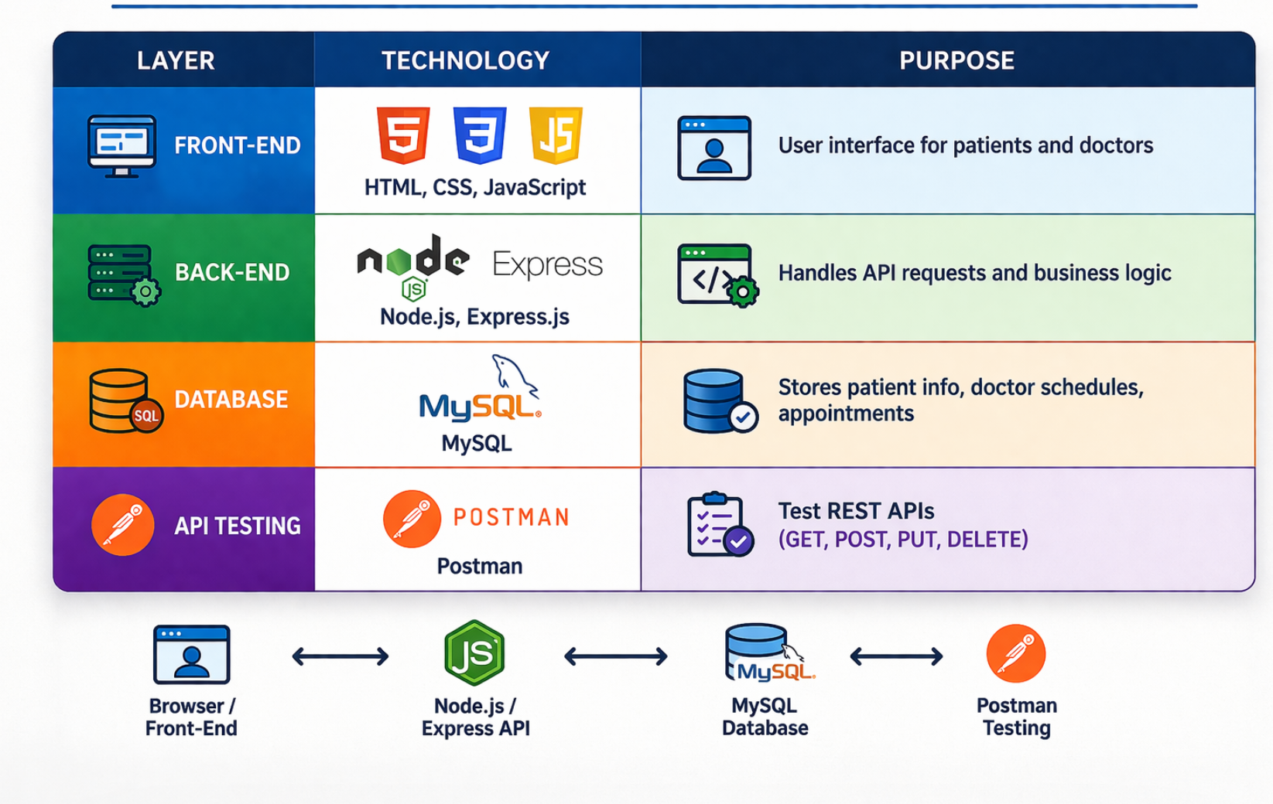
Technologies Used:

Slide 11
Future Enhancements
Add
Add database support for persistent data
Add
Add email/SMS notifications for appointments
Improve
Improve UI/UX with React or Angular
Add
Add admin panel for hospital management

Slide 12
Conclusion
Simplifies appointment management
Reduces manual errors
Provides real-time access to schedules
Helps both patients and doctors efficiently

Slide 13

Thank you

